Slide 1
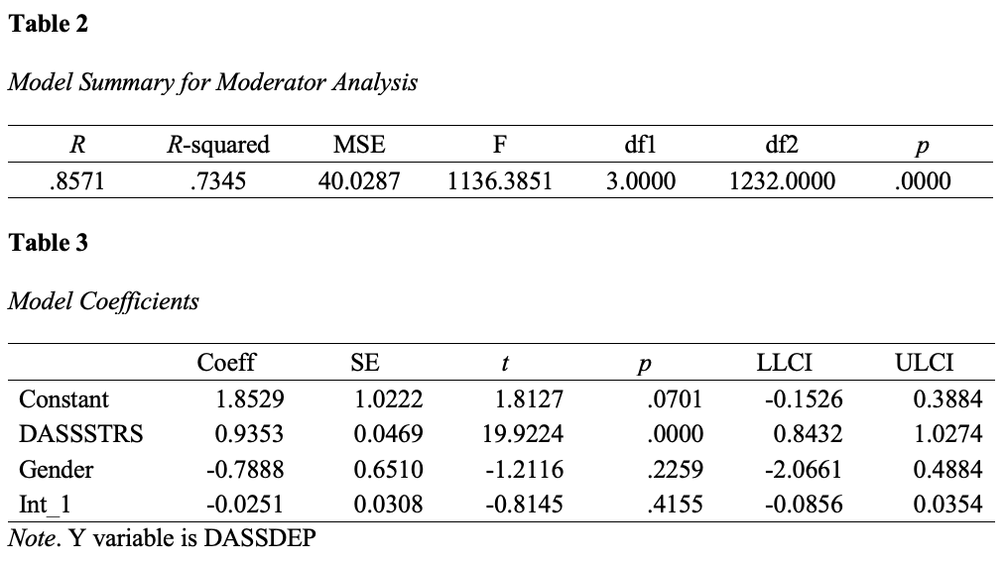
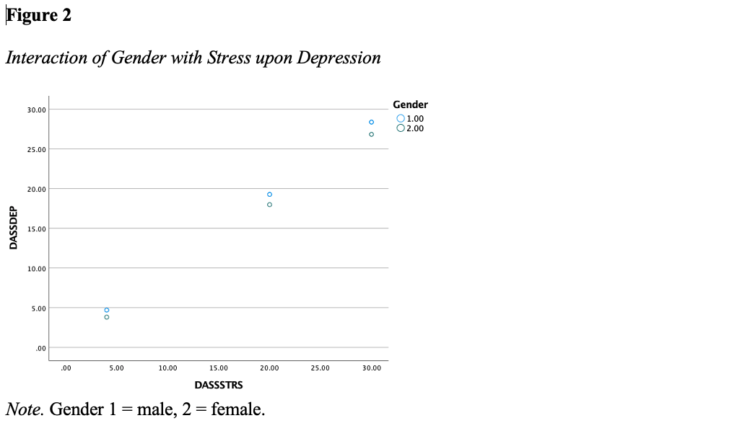
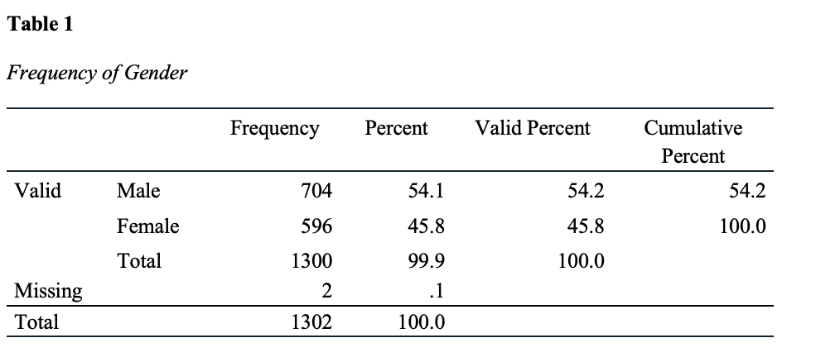
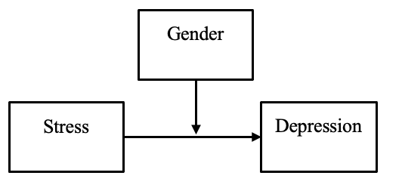
Examining Gender as a Moderator of Stress and Depression
Sparky Flame
Introduction
Measures
Results
Discussion
Engaging Introduction goes here
Present the background of the problem much like you did in Topic 4, Literature Review, Synthesis.
Present the need for further research much like you did in Topic 4, Literature Review, Conclusion.
Gender, as self-identified, a categorical-nominal level of measurement. Gender is the moderator (W) variable.
Stress, as measured by DASS-Stress, a continuous-interval level of measurement. Stress is the predictor (X) variable.
Depression, as measured by DASS-Depression, a continuous-interval level of measurement. Depression is the criterion (Y) variable.
A moderator analysis using PROCESS (v.4.0; Hayes, 2018) was conducted to test the null hypothesis. There was a significant predictive effect between Stress and Depression, t = 19.9224, p < .001, b = 0.9353. The result of the interaction effect between gender and Stress upon Depression was not statistically significant, t = -0.8145, p = .4155, b = -0.0251. See Tables 2 and 3.
The results failed to reject the null hypotheses, which stated that gender does not significantly moderate the predictive effect between Stress (X) and Depression (Y). The results suggest that although there is a significant predictive effect between Stress and Depression, the extent of the effect between Stress and Depression is not dependent upon one’s gender, as shown in Figure 2.
The predictive effect, as presented by Smith (xxxx) and Brown (xxxx) were observed within this study’s results, as well. However, unlike the results demonstrated by Jones (xxxx), which suggested that gender may be a moderating factor between stress and depression, the results of this study demonstrated gender does not moderate the predictive effect between stress and depression.
Limitations
The limitations of this study include using an archival dataset, which may have been developed using a different theoretical foundation or study purpose. Additionally, the conclusions are limited by the unknown validity or reliability of the data collection efforts in developing the archival data.
Future Research
Future research should consider collecting primary data directly from participants. Considerations should be given to ensuring a representative sample or, alternatively, by focusing upon specific groups (e.g., doctoral students, 18–35-year-old participants, etc.)
Research Question & Hypotheses
Procedure
RQ: To what extent, if any, does gender moderate the predictive effect between Stress (X) and Depression (Y)?
H0: Gender does not significantly moderate the predictive effect between Stress (X) and Depression (Y).
H1: Gender significantly moderates the predictive effect between Stress (X) and Depression (Y).
A simple moderator analysis using Hayes (2018) model 1 was completed using the variables gender as the moderator (W), Stress as the predictor (X) and Depression as the criterion (Y) obtained from the EDCO 745 course dataset. The data were screened and tests of assumptions for multiple regression were completed. Although there was a minor deviation from normality for the residuals, the data were not transformed. Violation of the normality of residuals does not lead to issues with significance testing, particularly with larger sample sizes, and does not suggest any discrepancies with model coefficients should be anticipated. Instead, this violation may be an indication that a better regression model may be needed (Cohen et al., 2003). The tests of assumptions demonstrated the data are suitable for conducting the moderator analysis.
The research question was addressed by testing the null hypothesis. The relationships examined are presented in Figure 1.
Figure 1
Conceptual Model of Simple Moderator Analysis
References
Cohen, J., Cohen, P., West, S. G., & Aiken, L. S. (2003). Applied multiple regression/correlation analysis for the behavioral sciences (3rd ed.). Routledge.
Hayes, A. F. (2018). Introduction to mediation, moderation, and conditional process analysis: A regression-based approach (2nd ed.). Guilford Press.
Sample
The sample for the study consisted of records aggregated in the EDCO 745 dataset (N = 1,300), differentiated by gender of male (n = 704) and female (n = 596), as presented in Table 1.
Notes:
Leave yourself notes if you would like. (also, present this at research week!)
1

