Slide 1
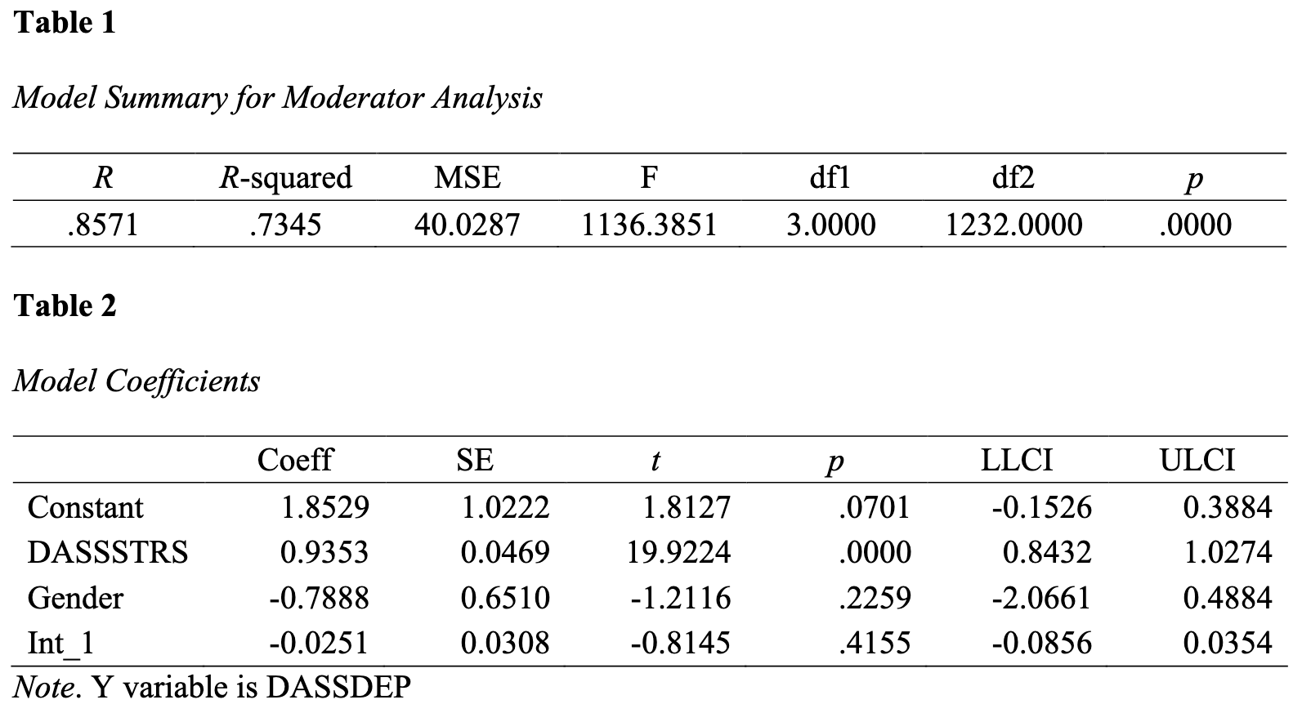
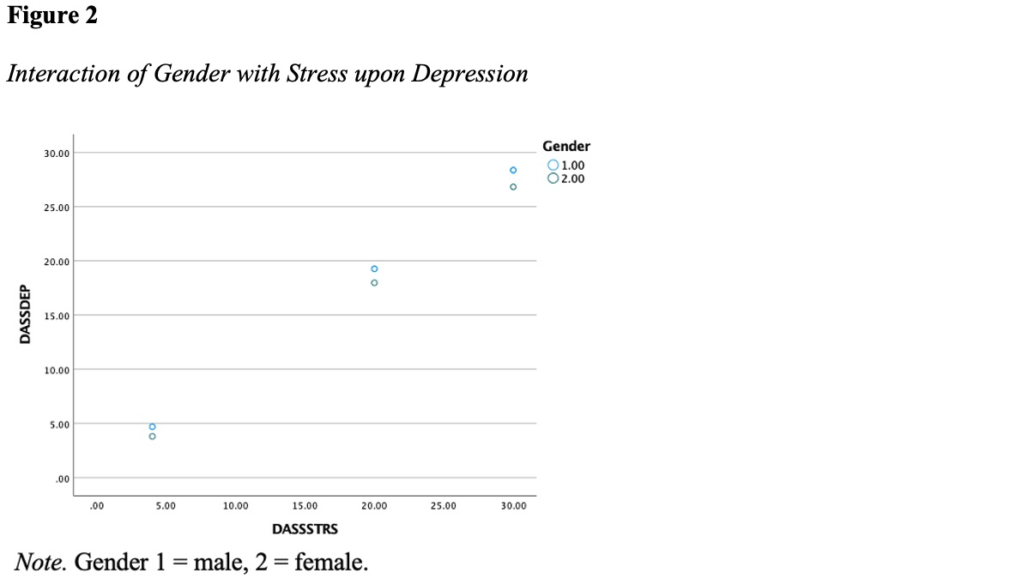
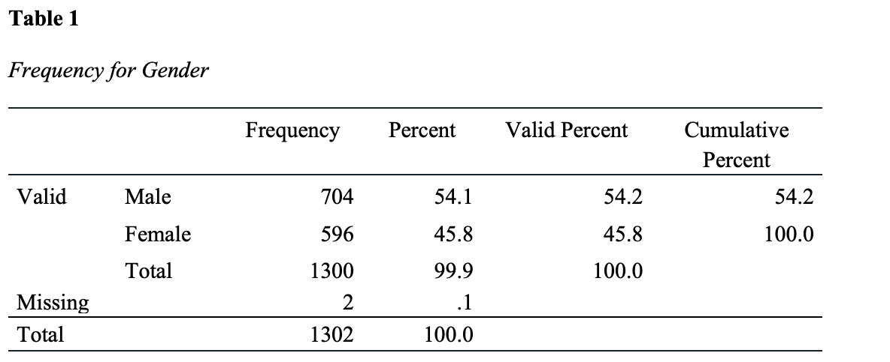
Concise and Informative Title
Names of Contributors
Introduction
Measures
Results
Discussion
Engaging Introduction goes here
Present the background of the problem much like you did in Topic 4, Literature Review, Synthesis.
Present the need for further research much like you did in Topic 4, Literature Review, Conclusion.
Keep the presentation relatively concise, so that it fits within the allotted space.
Talk about independent variables here.
Identify the variable (independent, predictor, antecedent, X) by name, identify the instrument used to measure the variable, and identify the variable level of measurement. For example,
In any research presentation, one must present the variables that are being examined. One must identify the variables, describe how the variables were measured, and describe the level of measurement for each variable. Identify the role of each variable in the study. A simple format for this was described in Week 2: Quiz: Pick Topic Assignment. If using the analysis from the Week 7 Regression Data Output and Write-up assignment, you should be able to copy and paste directly from the previous work.
For more information on variables, see Warner Chapter 1, p. 19
Explain results here.
Describe the outcome of the tests. As with all scholarly writing, one begins with a narrative description of the results, then one presents the figures and/or tables that support the results. The write up for the results often tend to be very brief, as one is only presenting the outcome of the statistical test—the interpretation comes later in the Discussion section. If you are using the Week 7 assignment, you may copy and paste directly from it into this section.
Discuss the study and its findings here.
Limitations
What were your study’s limitations?
Future Research
What would you recommend future researchers do in light of your research findings?
Research Question & Hypotheses
Procedure
RQ: To what extent, if any, does gender moderate the predictive effect between Stress (X) and Depression (Y)?
H0: Gender does not significantly moderate the predictive effect between Stress (X) and Depression (Y).
H1: Gender significantly moderates the predictive effect between Stress (X) and Depression (Y).
Describe your procedure or method here.
Present an overview of the important steps one completes to prepare the data and test the hypothesis. Although the course spends time on ensuring the data are prepared and appropriate for hypothesis, such data preparation is not the main part of an analysis. As such, it is adequate to describe that data were retrieved and tests of assumptions were completed. The reader will expect that tests of assumptions met the assumptions unless you describe otherwise. For example, if there was a minor deviation of normality, then one would describe it and address how that deviation was handled. Otherwise, the adage of no news is good news is applicable. DO NOT PRESENT ANY DATA SCREENING FIGURES OR TABLES AS PART OF THE POSTER ASSIGNMENT.
With the data prepared, one should then describe how the data were used to test the hypothesis. The writeup for this section may be copied directly from the writeup for the Week 7 Regression Data Output and Write-up assignment with some minor editing.
Describe the statistical test you will complete. If using a moderation or mediation analysis, include a figure of the model being used.
Figure 1
Simple moderation model
References
Provide the references used for this poster. This includes references used in the Introduction, as well as any references to tools used in the statistics (e.g., Hayes, 2018). Be sure correct APA (7th ed.) formatting is used.
Sample
The sample section describes the participants of the study from whom data were collected. Descriptions of the sample include how many total participants were in the study and listing of the relevant characteristics. For example, if the sample was 1,300 of which 704 were male and 596 were female, then one would describe the sample size and present a frequency table of the genders. One may use a bar chart to visually present the information; however, keep in mind the frequency values (the numbers for each category) must still be presented.
Notes:
Leave yourself notes if you would like. (also, present this at research week!)
1

