Slide 1
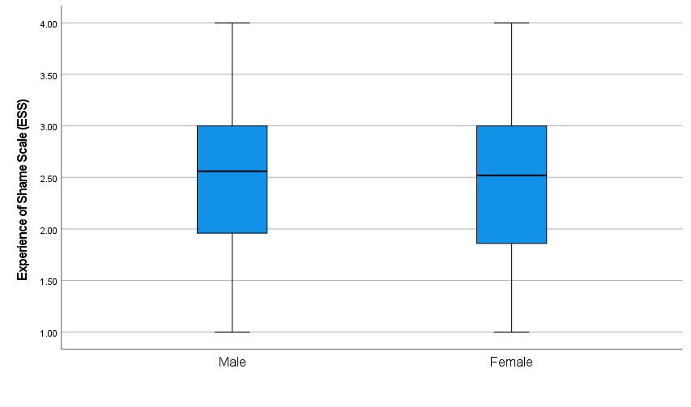
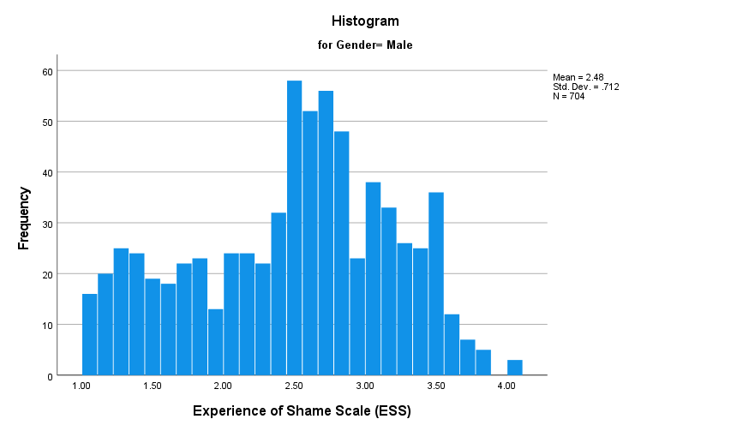
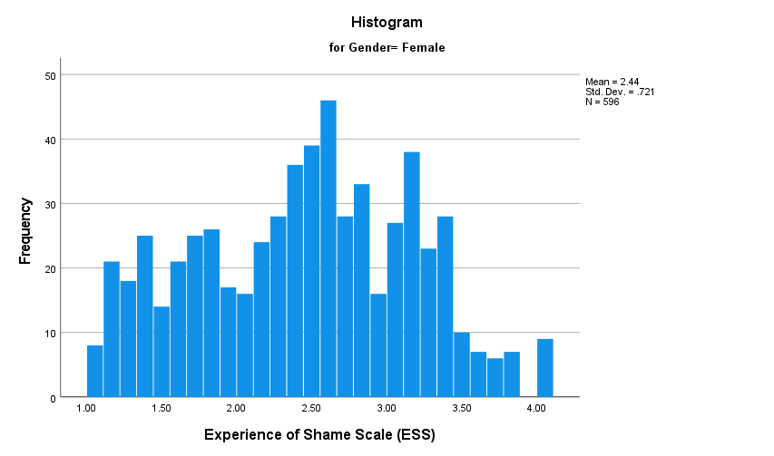
Gender as a Possible Moderator
of the Predictive Effect Between Anger and Shame
Shannon Goodwin
Introduction
Variables
Instruments
Discussion
Shame is a complex emotion manifested in negative evaluations of oneself while also provoking acute, physiological changes in the body that can jeopardize one’s health (López-Castro et al., 2019). Because of its impact on people’s lives, there has been growing interest in the scholarly and psychological research about different conceptualizations of shame and various aspects of psychosocial functioning and well-being (Velotti et al., 2017). The conceptualization of shame occurred alongside efforts to understand its causes, associations, predictors, and relationships.
Most researchers treat shame as distinguishable, with an understanding that shame is a unique phenomenon that can lead to predictable human behaviors and behavioral outcomes (Shen, 2018). Shame, as experienced by different genders, has been a subject of interest, but there have been mixed findings about the possible relationship between variables.
Gender is a categorical variable that involves a nominal level of measurement.
Sexual activity is a categorical variable that involves an ordinal level of measurement.
Shame is a continuous variable that involves an interval level of measurement, as assessed by the Experience of Shame Scale (ESS) (Andrews et al., 2002).
Anger is a continuous variable that involves an interval level of measurement, as assessed by the PROMISANG (an Anger Scale) (Shepherd & Evans, 2020).
The Experiential Shame Scale (ESS) has been validated among diverse populations. The 25 items (written in a 4-point Likert-type scale format) are answered through the self-reported perceptions of respondents. There are four areas of characterological shame (personal habits, manners, self-appraisal, and abilities). There are three areas of behavioral shame (doing or saying something wrong or stupid and competitive failures). Bodily shame pertains to feeling ashamed of one’s body or any of one’s body parts. The questions also encompass experiential, cognitive, and behavioral domains (Vizin et al., 2016).
PROMIS-ANGER is a 5-point Likert, with item ratings summed for a total score for the five-item scale ranging from 5 to 25. Higher scores are associated with higher levels of anger severity (Kaman et al., 2022).
Because the results of the simple moderator analysis revealed that gender does not significantly moderate the predictive effect between Anger (X) and Shame (X), there is a justification for failing to reject the null hypothesis. While the results show a significant predictive effect between the variables (Anger and Shame), the extent of such an effect is not moderated by a person’s gender. Limitations to these findings include a secondary dataset that was impossible to further assess and that did not allow one to draw conclusions about the context, possible geographical influences, and other demographic factors that might have informed conclusions about the results of the study. Future research could include consideration of the other demographic variables, as well as the relationships of shame to particular phenomenon suspected to somehow relate to the construct.
What is also known is that shame, as experienced by different genders, has been a subject of interest, but there have been mixed findings about the possible relationship between variables. According to Dolezal and Lyons (2017), when individuals are stigmatized or marginalized for reasons out of their control (such as race or gender), shame may become a chronic experience because of persistent threats and feelings of social devaluation. This study did not account for the possible influence of stigmatization, marginalization, the persistence of threats, or other social experiences that might be more or less gender or demographically influenced or otherwise related to anger and shame. Additional research could follow these interests.
Given the historical discrimination of women as a social group, it may be possible that women experience shame at greater intensity, frequency, and/or duration than men. This study did not account for intensity, frequency, or duration, which could also be the subjects in future studies.
Model
Procedure
Research Question and Hypotheses
Gender (W)
Data screening and assumption tests were conducted to examine whether the variables, Shame (interval level of measurement) and Gender (categorical), as provided in the EDCO-745 course dataset, agree with the null hypothesis, which states there is no significant difference in Shame between the male and female gender.
In additions, a simple moderator analysis was performed using Hayes’ (2018) Model 1 using three variables, gender, anxiety, and shame. All data were derived from the EDCO 745 course dataset and were screened. Assumptions for multiple regression were tested. Tests of assumptions demonstrated that data were appropriate for running a moderator analysis. The moderator analysis occurred to test the null hypothesis using Hayes’ (2018) PROCESS v4.0.
Research problem: It is not known to what extent, if any, the relationship between anger and shame is moderated by gender.
RQ1: To what extent, if any, does gender moderate the predictive relationship between anger and shame?
Ho1: Gender does not significantly moderate the predictive relationship between anger and shame.
Ha1: Gender significantly moderates the predictive relationship between anger and shame.
Anger (X) PROMIS-ANG
Shame
(Y) ESS
Data Assumptions
Shame is a dependent variable measured by ESS with a continuous, interval level of measurement.
Gender is an independent, dichotomous variable.
Gender contains two separate and distinct group where membership data in one group (i.e., females) cannot contribute to membership data in the other group (i.e., males).
A boxplot was generated for the dependent variable ESS for both groups of independent variable and there were no significant outliers for males or females.
Normality is observed with histograms of ESS distribution for males and females.
Levene’s test for ESS was not statistically significant, F(1,1298) = .40, p = .53, indicates homogeneity of variances.
Boxplot
Results
References
Sample
Results include a significant predictive effect between Anger and Shame, t = 25.1366, p < .0000, b = .0816. For the interaction between Gender and Anxiety on Shame, there was no statistical significance, t = -1.1031, p = .2702, b = .0071.
Model Summary for Moderator Analysis
R R-sq MSE F df1 df2 p
.5730 .3284 .3553 211.8591 3.0000 1300.0000 .0000
Model Coefficients
Coeff SE t p LLCI ULCI
Constant 2.5584 .0165 154.7494 .0000 2.5260 2.5908
PROMISAn .0816 .0032 25.1366 .0000 .0753 .0880
Gender .0478 .0328 1.4581 .1450 -.0165 .1121
Int_1 -.0071 .0064 -1.1031 .2702 -.0197 -.0055
Cundill, B., & Alexander, N. D. (2015).Sample size calculations for skewed distributions. BMC Medical Research Methodology, 15, 28-33. https://doi.org/10.1186/s12874-015-0023-0
Dolezal, L., & Lyons, B. (2017). Health-related shame: An affective determinant of
health? Medical Humanities, 43(4), 257–263. https://doi.org/10.1136/medhum-2017-011186
Eslinger, P., Anders, S., Ballarini, T., Boutros, S., Krach, S., Mayer, A., Moll, J., Newton, T., Schroeter, M. L., Oliveira-Souza, R., Raber, J., Sullivan, G. B., Swain, J., Lowe, L., & Zahn, R. (2021). The neuroscience of social feelings: Mechanisms of adaptive social functioning. Neuroscience and Biobehavioral Reviews, 128, 592–620. https://doi.org/10.1016/j.neubiorev.2021.05.028
Kaman, A., Otto, C., & Devine, J. (2022). Assessing anger and irritability in children: psychometric evaluation and normative data for the German version of the PROMIS® Parent Proxy Anger Scale. Qualitative Life Research, 31, 831–839. https://doi.org/10.1007/s11136-021-03001-1
Shanks, D. R. (2017). Regressive research: The pitfalls of post hoc data selection in the study of unconscious mental processes. Psychonomic Bulletin & Review, 24(5), 752–775. https://doi.org/10.3758/s13423-016-1170-y
Shen, L. (2018) The evolution of shame and guilt. PLoS One, 13(7). Article e0199448.
https://doi.org/10.1371/journal.pone.0199448
Velotti, P., Garofalo, C., Bottazzi, F., & Caretti, V. (2017) Faces of shame: Implications for self-esteem, emotion regulation, aggression, and well-being. The Journal of Psychology, 151(2), 171-184, DOI: 10.1080/00223980.2016.1248809
Vizin, G., Urbán, R., & Unoka, Z. (2016). Shame, trauma, temperament, and psychopathology:
Construct validity of the Experience of Shame Scale. Psychiatry Research, 246, 62-69.
https://doi.org/10.1016/j.psychres.2016.09.017.
Warner, R. (2020). Applied statistics I (3rd ed.). SAGE Publications.
There were 1304 people who provided answers to the question of gender. Fifty-four percent of the respondents selected male (n = 704) and 45.7% selected female (n = 596). Four respondents chose the other category.
Notes:
Leave yourself notes if you would like. (also, present this at research week!)
1

